Slide 1
Redshift -ETL
Vikas

Slide 2
Introduction
Redshift is an enterprise-level, petabyte-scale, fully managed Datawarehouse service.
Datawarehouse is a data management system that is designated to enable and support business Intelligence activity, especially analytics.
Redshift supports all core functions of the Data warehouse. It’s scalable, performant, cost-effective, easy to manage, ML optimized, and Integrated with 3’rd part tools and various AWS services. It’s SQL ready.
Notes:
STAR schema has fact and dimensions tables. Facts tables contain events and observations that can be measured. eg Sales & Listing
Dimension tables provide information on business entity 5 in our example.
OLTP – Operational & transactional data stored in a relational DB
continuously changing
OLAP – Subject & analysis. Stored in star, snowflake, or fact constellation models.
historic or static data

Slide 3
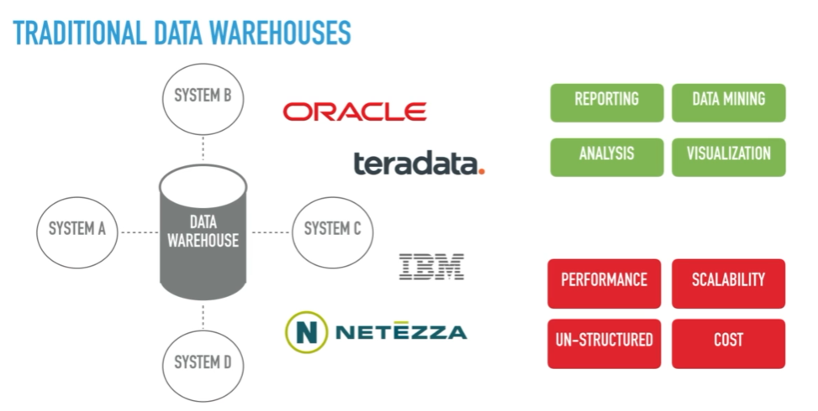

Slide 4
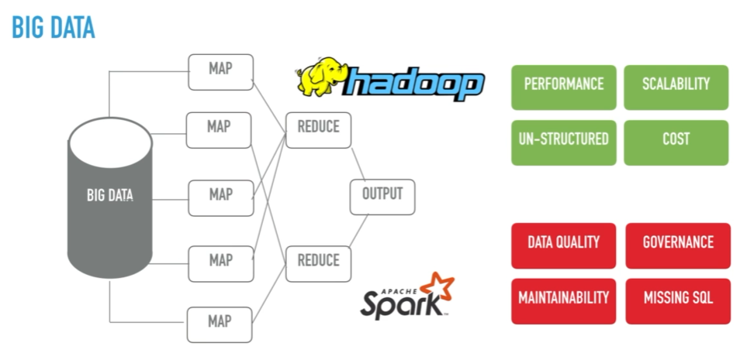

Slide 5
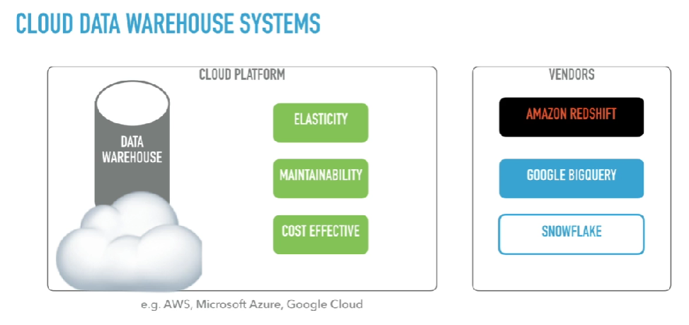
Notes:
NOSQL DB:
========
Document - MongoDB
Key-Value - Redis
Graph – neo4j
Columnar - Redshift

Slide 6
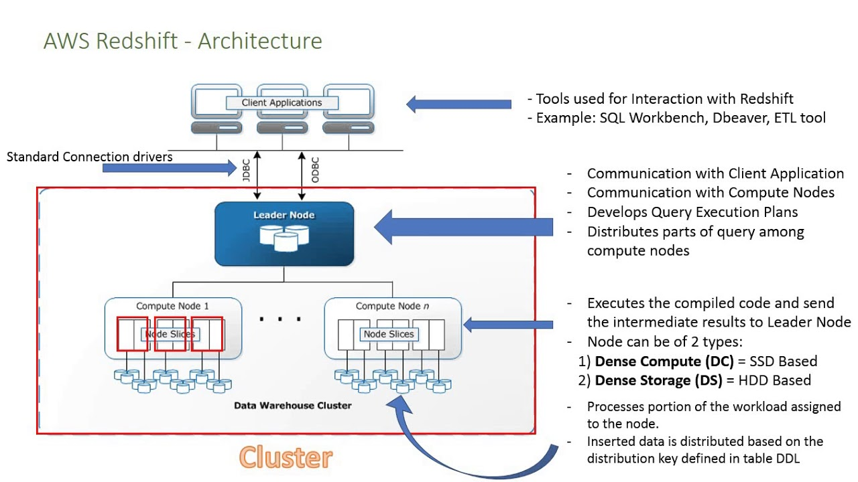
Notes:
https://docs.aws.amazon.com/redshift/latest/gsg/rs-gsg-create-sample-db.html
Use COPY Command to copy data as its uses MPP via multiple streams.
Data can come from s3, EMR, DynamoDB etc.

Slide 7
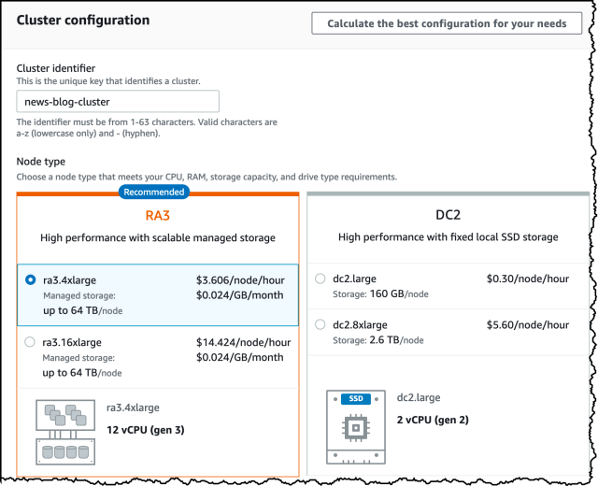
Notes:
https://www.stackovercloud.com/2020/04/02/amazon-redshift-update-ra3-4xlarge-nodes/

Slide 8
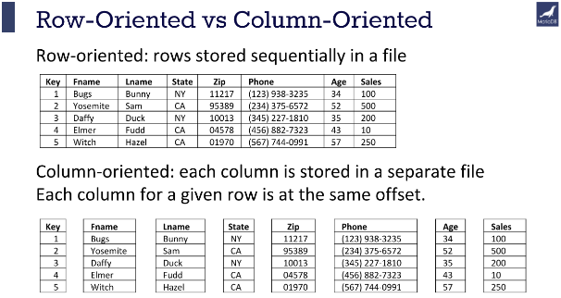
Notes:
Data is internally stored in a cluster of PostgreSQL.
Columnar data is compressed which saves space and increases I/o. It supports encoding techniques like LZO, ZSTD & AZ64.
Additional metadata is stored in Zone maps, which will allow me to skip data blogs that don’t satisfy the matching condition, Hence improving performance.
Compression reduces data size hence less storage is required which increases query performance and decrease data scanning hence the cost is reduced.
Data Distribution – uniform workload distribution + minimize data movement.
Data Sort – sort keys
High bandwidth connectivity between compute and leader node gives massive parallel processing power.
AQUA – Advanced query accelerator

Slide 9
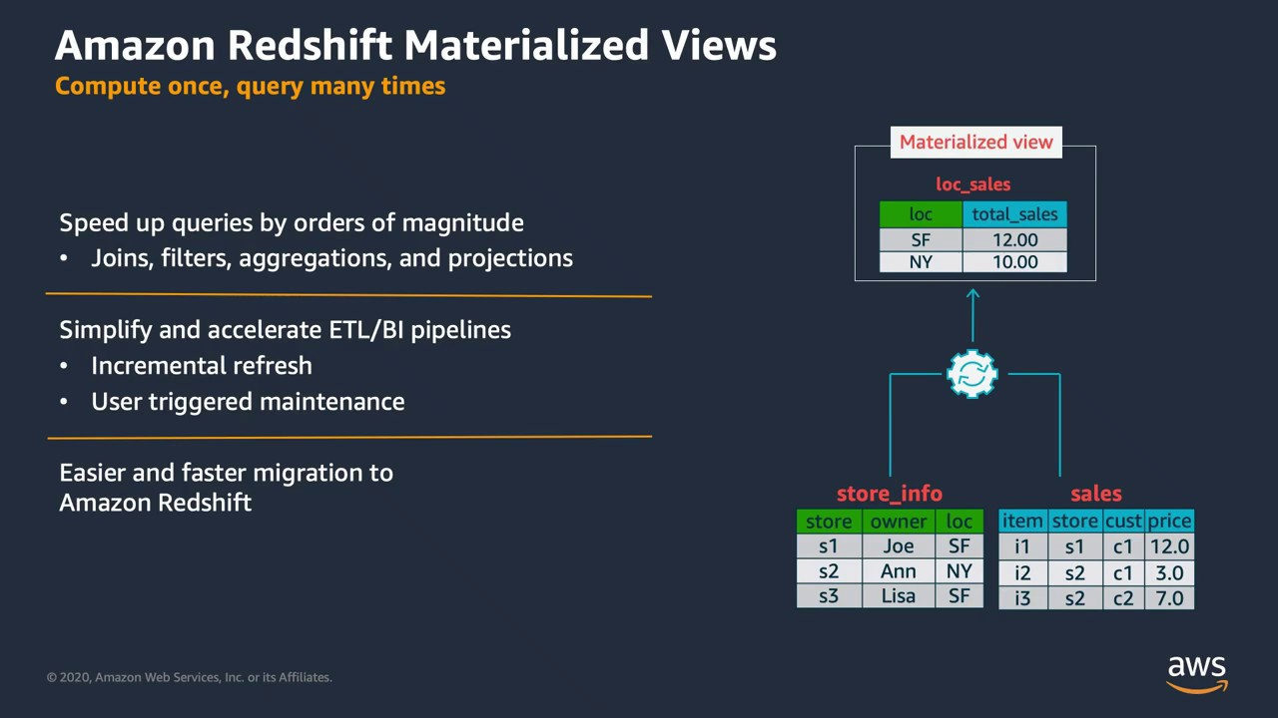
Notes:
Materialized views precomputed results
Complex queries: Large tables, multiple joins, and aggregates
Repetitive: Runs frequently and predictive output
Incremental refresh or full refresh (with auto refresh – Yes)

Slide 10
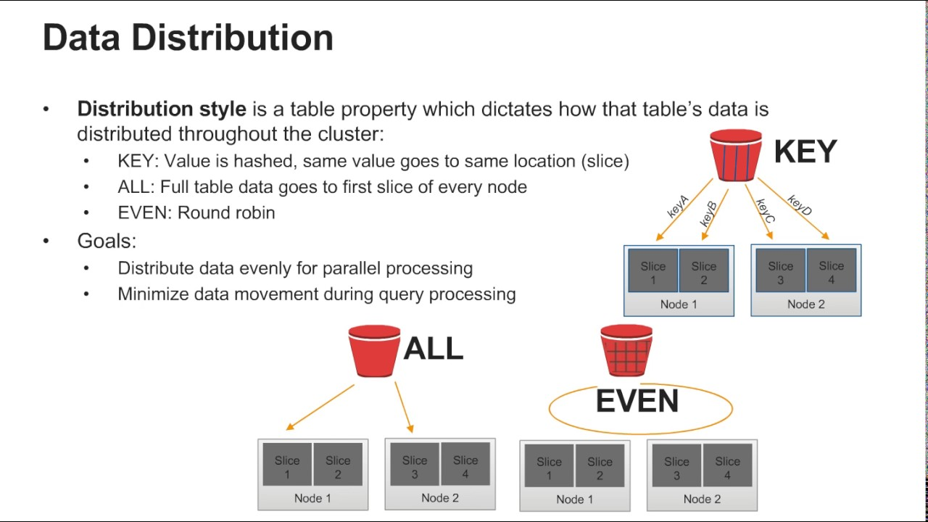
Notes:
Table Design & optimization:
Distribution Key
Sort Key
Compression
ALL – Simplest as a copy of the entire table is distributed to every node. All the users are copied to all the nodes in the cluster so no redistribution on the data side but longer data loads. Time is taken to update data. Good for slow-moving data which is not updated frequently.
Even – Each slice is chosen in a round-robin manner and data is distributed evenly regardless of the values in the column. Good with single table but fails when we have joined on multiple tables.
Key- Matching values are stored on the same node slice like a city
AUTO – Redshift does this distribution by default, and provides the optimal distribution type based on the size of the table. Auto-selection and distribution are done by Redshift ML but you have no control.
ALTER TABLE <TABLE_NAME> ALTER DISTSTYLE AUTO|ALL|EVEN|KEY [DISTKEY KEY_COLUMN]
Check query pattern before deciding on DISTKEY
https://docs.aws.amazon.com/redshift/latest/dg/c_choosing_dist_sort.html

Slide 11
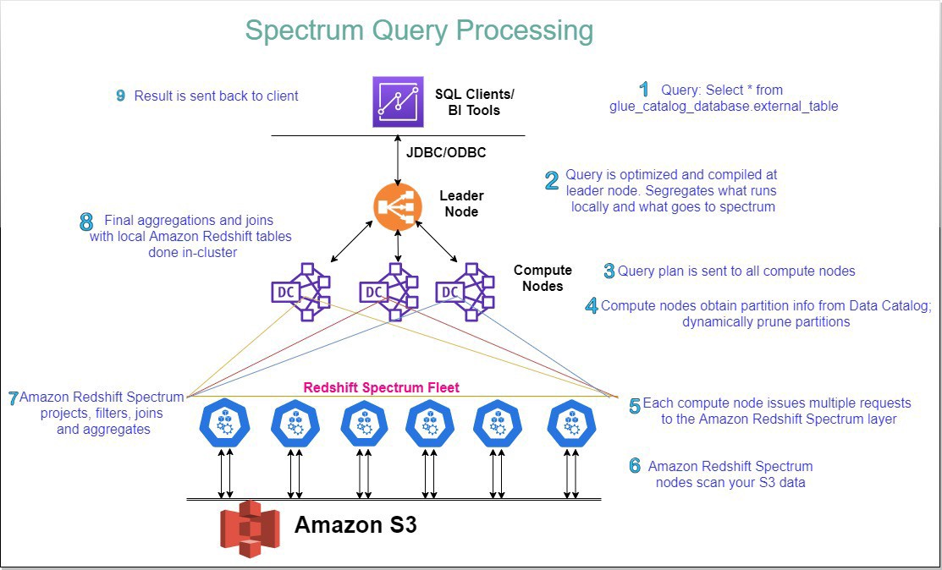
Notes:
Redshift supports automated tasks for configuring, monitoring, backing up, and securing the data warehouse.
Redshift Spectrum is the ability to perform analytics directly on the data in the Amazon s3 cluster using a Redshift node.
Resize
Pause/resume
Delete
Snapshot
Monitoring

Slide 12
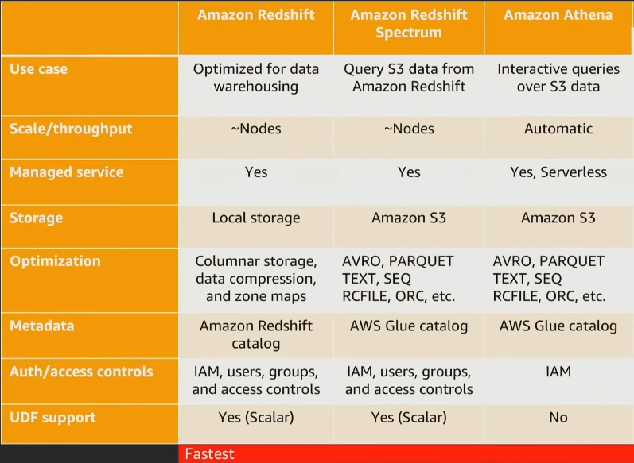
Notes:
https://docs.aws.amazon.com/redshift/latest/dg/c-getting-started-using-spectrum.html
Create an IAM role – Redshift Customizable – s3readonlyaccess, glue full access
Associate with redshift
https://docs.aws.amazon.com/redshift/latest/dg/tutorial_customer_churn.html

Slide 13
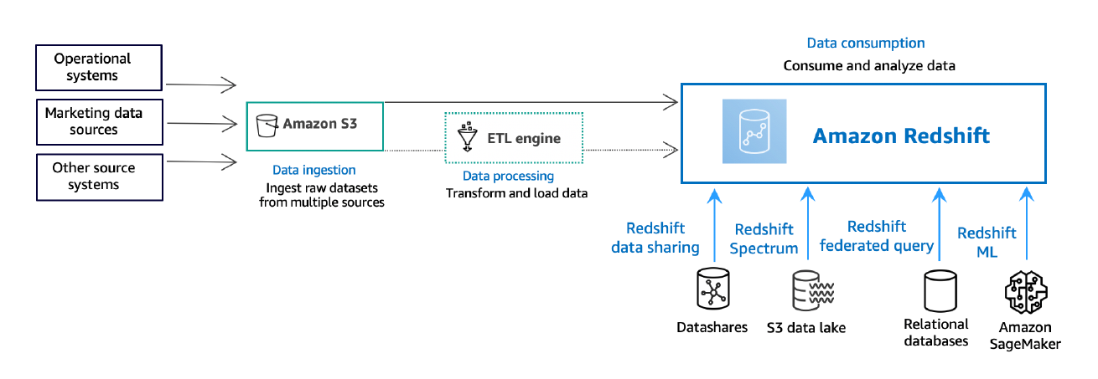
Notes:
Security & Data Protection:
Data Protection – Encryption at rest and transit [Cluster Properties KMS / Parameter group – require SSL]
IAM – Authentication & Authorization
Logging & Monitoring
Infrastructure – VPC & SG

Slide 14
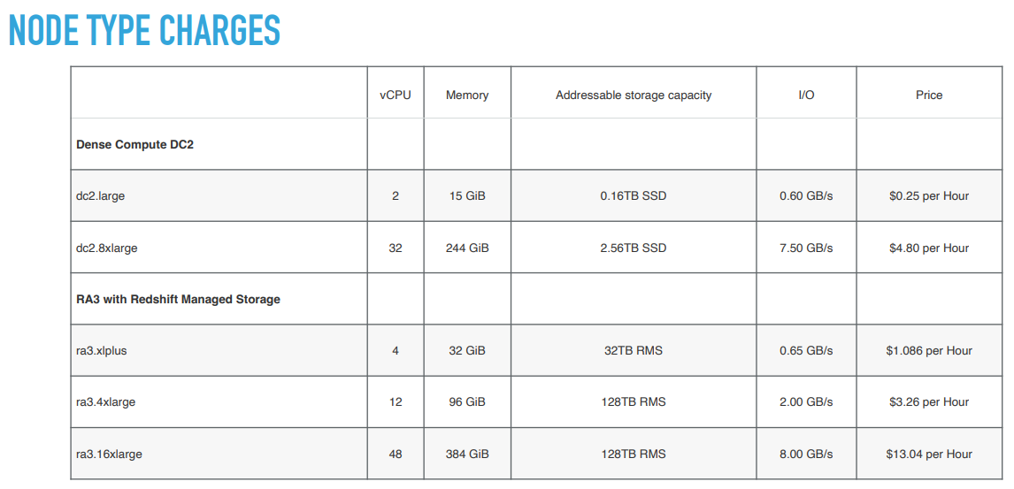

Slide 15
